Slide 1
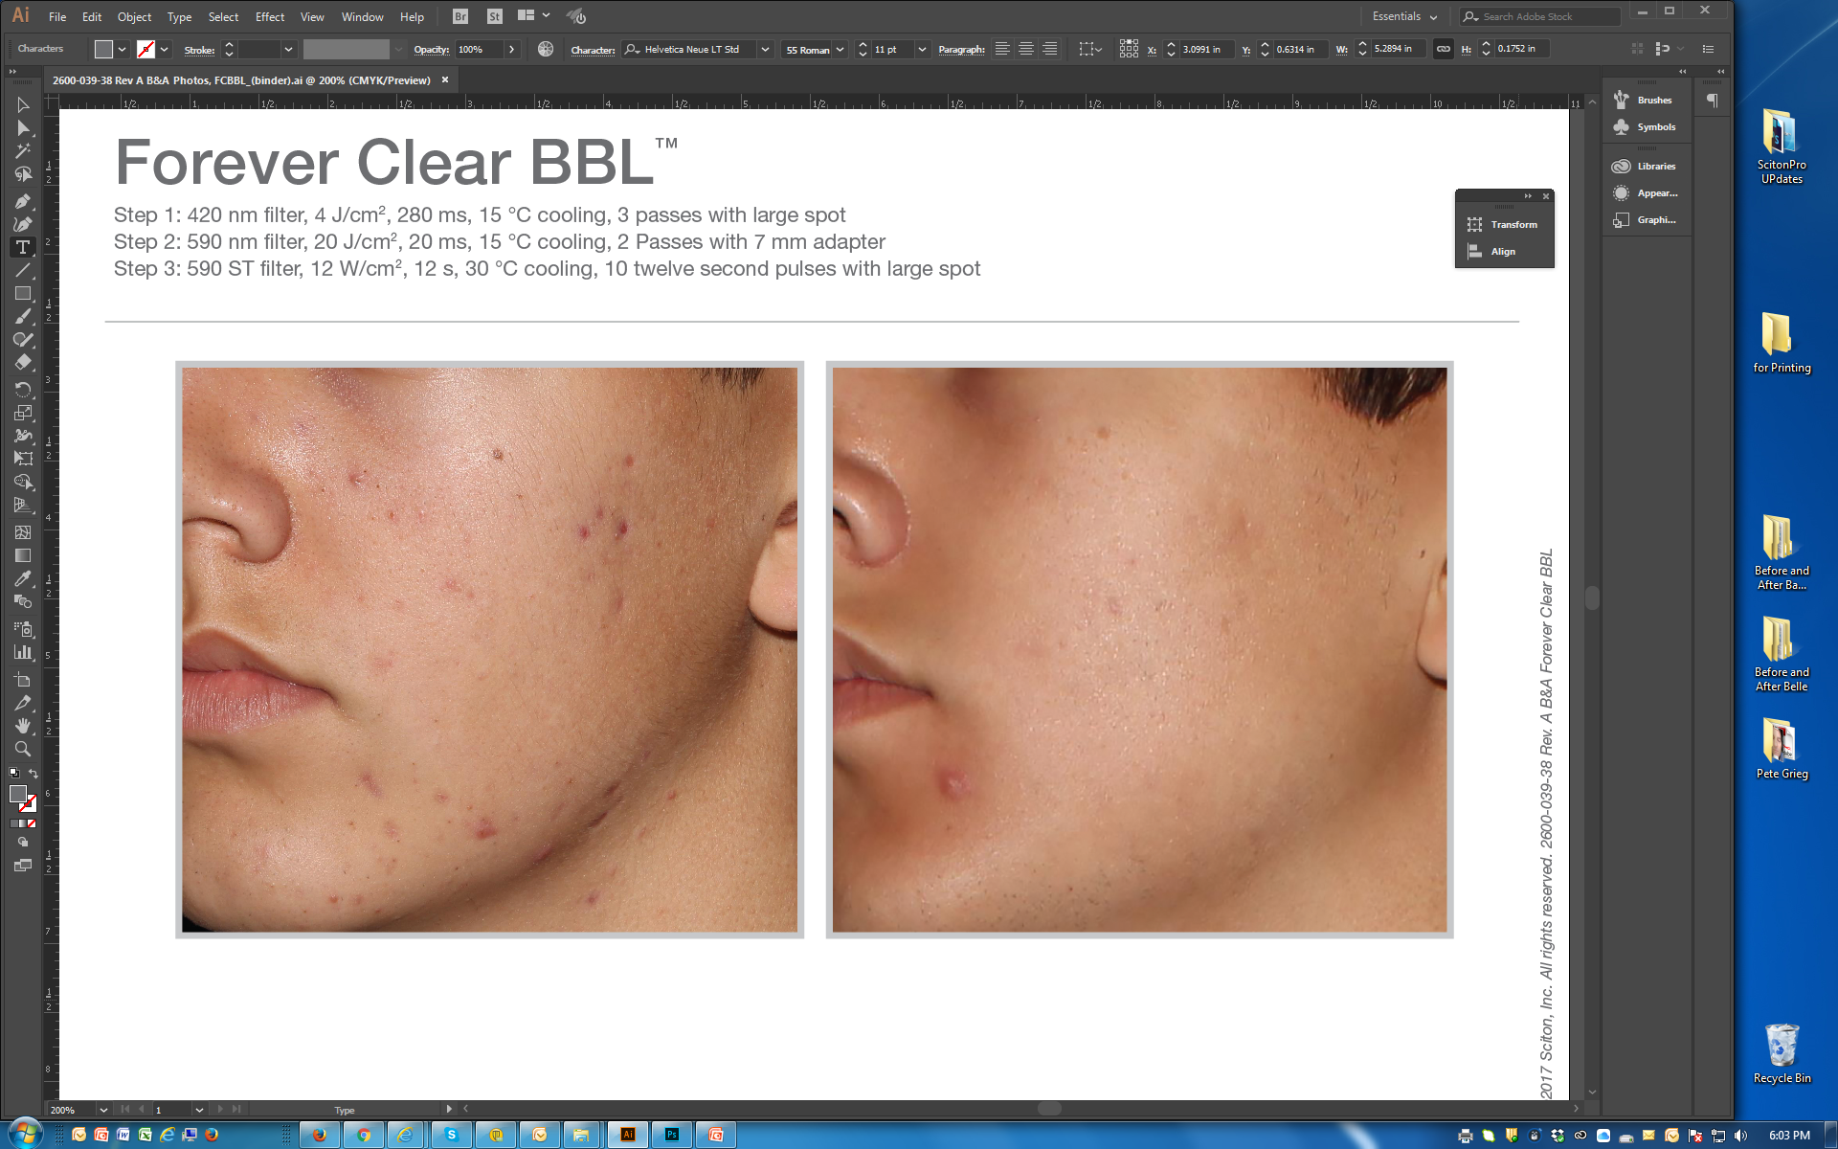
BEFORE / AFTER | 3.5 months post 9 tx | courtesy of Patrick Bitter, Jr., MD
Forever Clear BBL™
Step 1: 420 nm filter, 4 J/cm², 280 ms, 15 °C cooling, 3 passes with large spot
Step 2: 590 nm filter, 20 J/cm², 20 ms, 15 °C cooling, 2 Passes with 7 mm adapter
Step 3: 590 ST filter, 12 W/cm², 12 s, 30 °C cooling, 10 twelve second pulses with large spot
©2017 Sciton, Inc. All rights reserved. 2600-039-38 Rev. A B&A FCBBL

